Slide 1
Stage IV Periodontitis
Advanced Periodontal Disease
May appear as any or all of the following forms of pathology: severe inflammation, attachment loss with deep pocket formation, gum recession, bone loss, pustular discharge, or tooth mobility.
Spontaneously bleeding gums.
Signs: animals will paw at their face, drop food while eating, and drool excessively.
Treatment consists of scaling, root planing, and surgical extraction of affected teeth.

Slide 2
Stage IV Periodontitis
Note- these teeth appear to have been cleaned already:

Slide 3
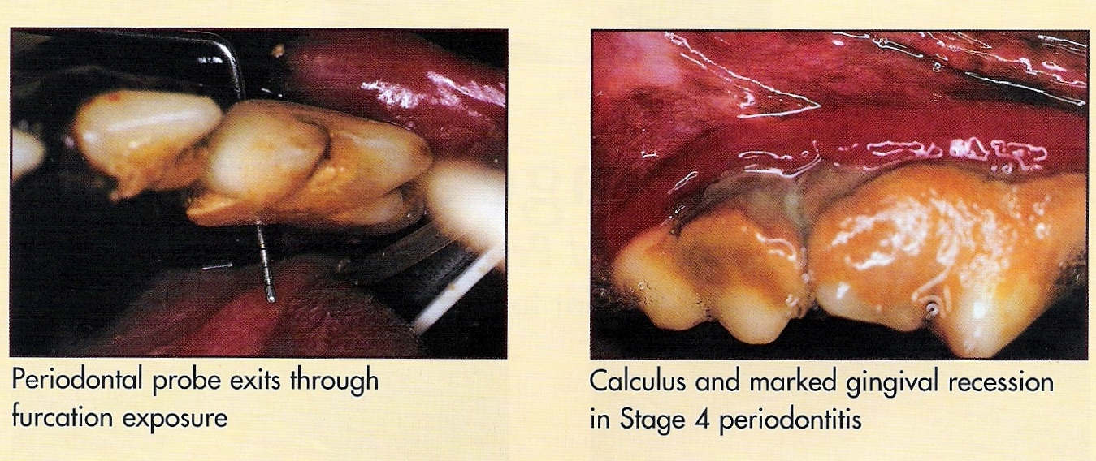
Cont. Stage IV Periodontitis

Slide 4
Stage IV Periodontal Disease
Periodontal disease has destroyed a significant portion of the alveolar bone and periodontal ligament of these incisor teeth. The gingiva has receded from the crowns of these teeth, and the tooth roots are now exposed.
This is an irreversible stage of periodontal disease!

Slide 5
Exodontics
Extraction of the tooth
Prognosis of tooth is grave
Client prefers low cost method
Multiple anesthesias are contraindicated in patient
Complications:
Anesthetic factors
Hemorrhage
Iatrogenic trauma
Closed extraction- single rooted teeth or teeth with severe periodontal disease
Surgical extraction- multi-rooted teeth with large surface area and strong attachment

Slide 6
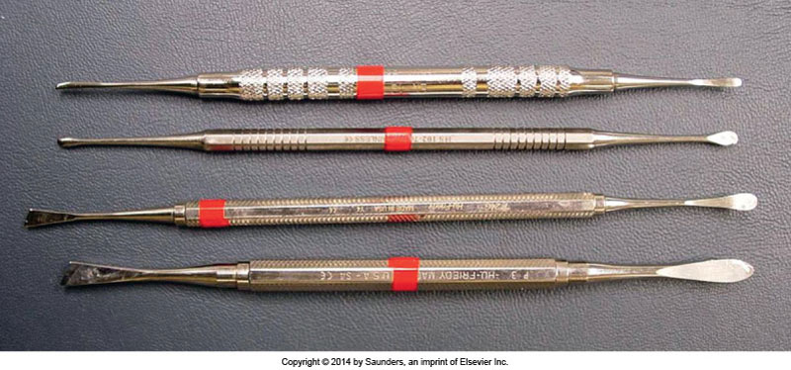
Instruments: Periosteal Elevators and Luxators
Goal is to weaken the PDL
Elevator is placed in between tooth and bone
Tool is rotated slightly, held, and then rotated
in the opposite direction and held
Tooth is separated from its gingival attachments
Index finger is extended to working end
Minimizes iatrogenic soft tissue trauma

Slide 7
Winged Elevators

Slide 8
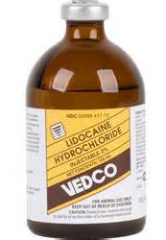
Extraction Prep
Pre and post radiographs
Regional nerve block
Delivered to specific nerves to block an entire region of mouth
Bupivacaine 0.5% and lidocaine 2%
Instruments:
Dental luxator/Periosteal elevators
Scalpels → gingival flap
Extraction forceps
Small suture
Sx: High speed hand piece/burs, scissors, curettes, dilute chlorhexidine, and root tip elevators if fx
Client instruction: no hard food or toys for 14 days
Bupivicaine used in mandibular block?

Slide 9
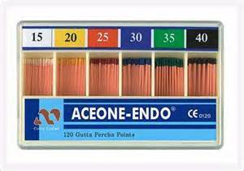
Endodontics
Pulp- nerves, blood vessels, lymph, and connective tissue; found in the pulp chamber and the root canal
As dentin is produced, the pulp chamber and root canal become smaller → stronger tooth
Should be completed by 1 to 1 and 1/2 years of age
Endodontic disease requires root canal therapy
Removal of pulp with a dental bur, shape with H-files or K-files, disinfect with sodium hypochlorite or bleach, dry with paper points, fill canal with Gutta Percha,
and place protective seal.

Slide 10
Oronasal Fistulas (ONF)
Holes formed between mouth and nasal cavity, usually secondary to periodontal ligament destruction.
Tooth becomes mobile and eventually falls out, leaving a communication between oral and nasal cavities.
Which teeth commonly affected?
CS include sneezing, and persistent, usually single sided, nasal discharge with or without bleeding.
Treatment includes surgery to close fistula.

Slide 11
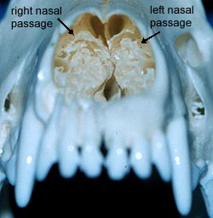
Oronasal Fistula

Slide 12
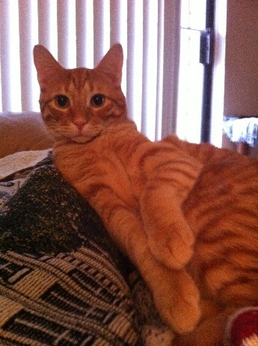
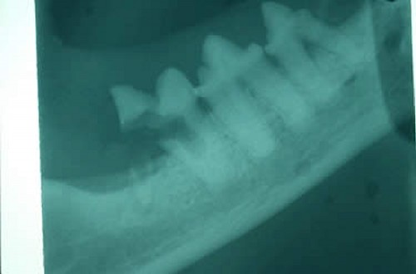
Tooth Resorption
Destruction of tooth structures
Lesions usually found clinically in
the cervical region
Easily hidden by gingiva
Which instruments help find these lesions?
Actually begin break down in the root structures…
How can we find this earlier?
Idiopathic
Vitamin D levels?
Extraction
“Cervical neck lesions”

Slide 13
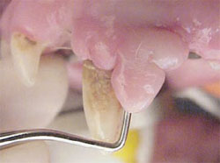
Gingival Hyperplasia
Thickening or over growth of gum tissue in an area.
Not a malignant condition.
How do we confirm this?
May be caused by periodontal disease.
Overgrowth of gingiva can increase sulcus depths, forming pseudopockets.
Treatment:
Remove tissue if needed
More prophylactic cleanings

Slide 14
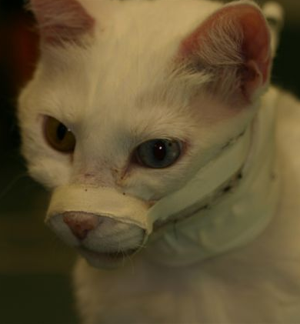
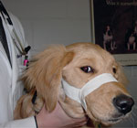
Trauma
Jaw Fractures
Most common type is symphyseal separation
Left and right mandibles separate from each other at the symphysis
Require rigid fixation for ~3-4 weeks
Ex. Cerclage wire, tape (puppies)
Tape muzzles- stabilize fracture until Sx
Adhesive side up!
Loose enough to allow tongue to move
between incisors → allows eating of slurry

Slide 15
Trauma
Tooth fractures
Canine and maxillary fourth premolar common
Main concern is pulp exposure
How do you find pulp exposure?
If crown is smooth, and there is a brown dot → attrition
If treated within 48 hours, can likely save the tooth
Vital pulp therapy
Must be treated at some point!
Pulp exposure is painful and can lead to infection (abscesses)
Endodontics or exodontics?

Slide 16
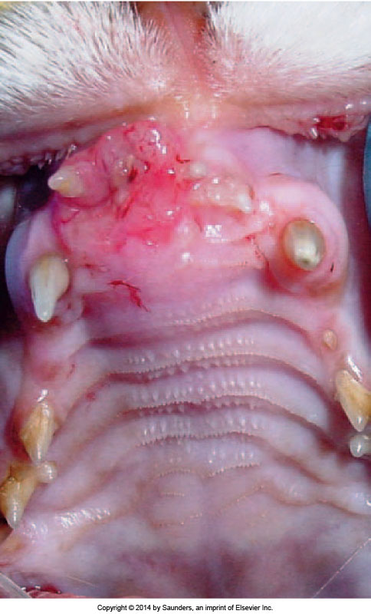
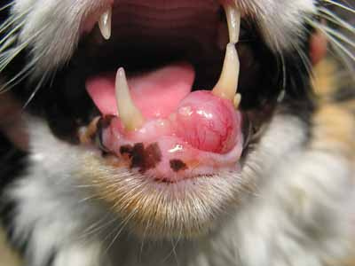
Oral Neoplasia
Rare in dogs and cats
SCC accounts for 70% of oral tumors in cats
Canine: Malignant melanoma, SCC,
fibrosarcoma, and osteosarcoma
CS/DS Maxillectomy/
mandibulectomy

Slide 17
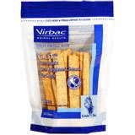
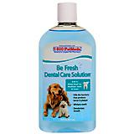
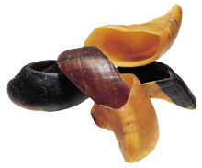
Client Education
Start young!
Inform client of periodontal disease during vaccination process
Explain home care oral hygiene techniques
Brushing with dentrifices, rinses/wipes, water additives
Mention acceptable bones and chews

Slide 18
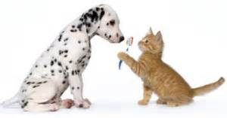
Home Care
BRUSH, BRUSH,BRUSH!
Start with water, then dentrifice
Begin caudal and buccal

Slide 19
Brushing Techniques
Stillman Technique:
Sweep in a coronal direction
*When is this used?
Bass Technique:
Bristles go into the sulcus

Slide 20
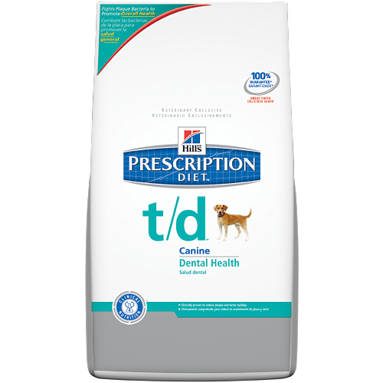
Client Education
Once routine dental cleanings begin: (1 -2 years of age)
Discuss the procedures actually performed and:
Possible complications
Medications
Diet changes (temp. or long term)
Prescription needed?
Discuss any follow up procedures needed
Prepare estimates
Helpful websites:
https://www.aaha.org/
http://vohc.org/index.htm

